Slide 1
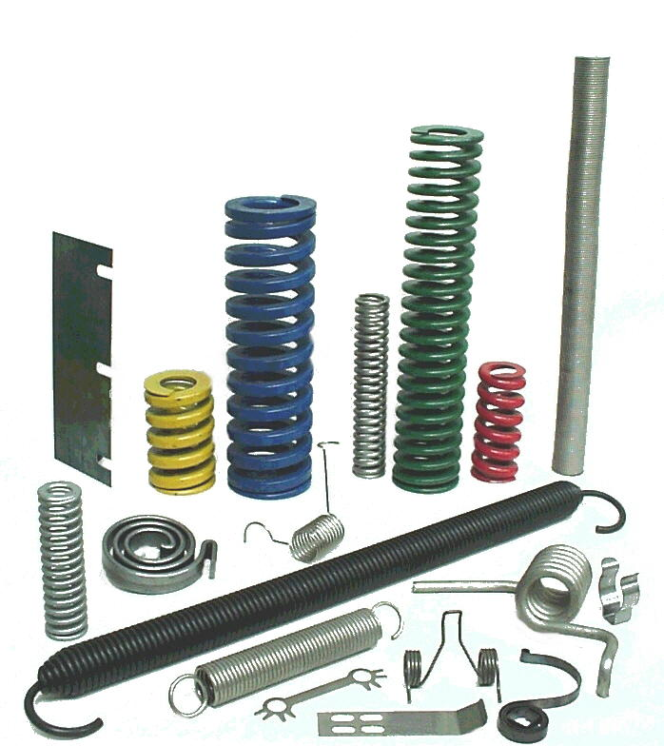
MECH 325 Spring Introduction

Slide 2
Objectives
By the end of this portion of the module, you should be able to:
Identify different types of springs and describe their uses
Determine force, deflection, and stress in compression, extension, and torsion springs as a function of geometry
Analyze compression springs in terms of buckling, spring surge, and fatigue

Slide 3
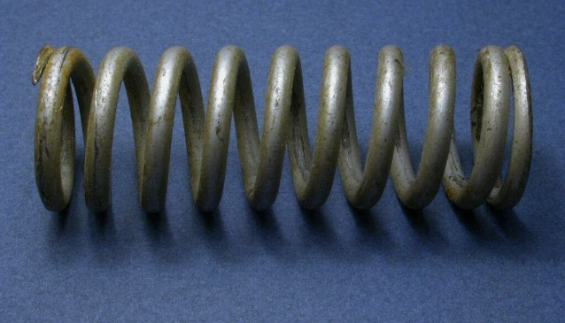
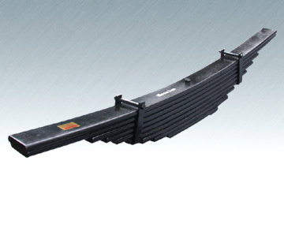
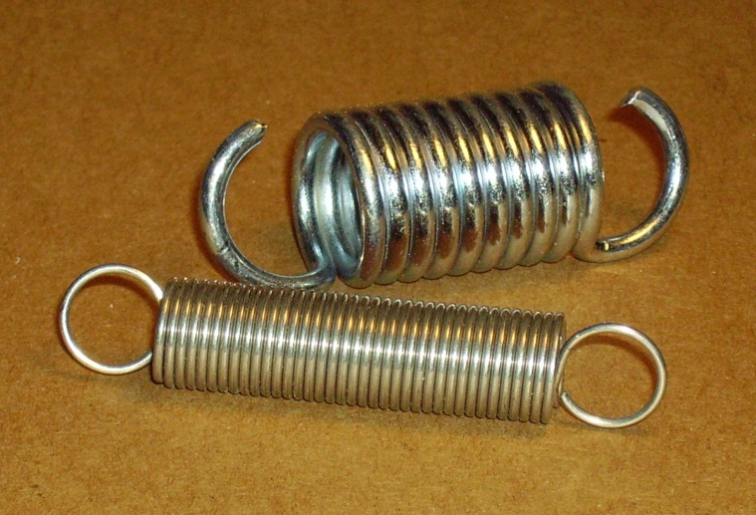
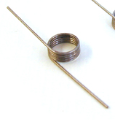
Spring Types
Helical Compression – axial compression
Leaf – simply supported
bending
Helical Tension (extension) – axial tension
Torsion - bending

Slide 4
Helical Spring Geometry

Slide 5
Helical Spring Forces
F
F
F

Slide 6
Helical Spring Forces

Slide 7
Helical Spring Stress
r
Curvature increases stress on inside, decreases slightly on outside
τ
T
T
F
r
τ
Higher Shear
T
Lower
Shear
T

Slide 8
Stress Correction Factors
Two models for helical spring stress corrections:
Wahl factor:
Bergstrasser factor:

Slide 9
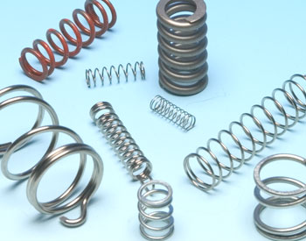
MECH 325 Compression Springs
Notes:
9

Slide 10
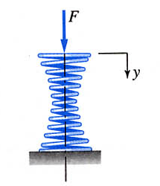
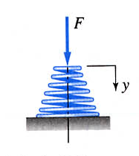
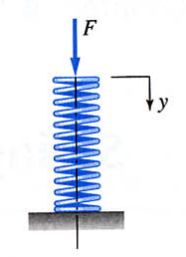
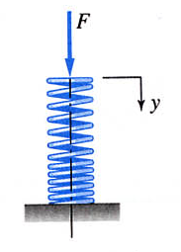
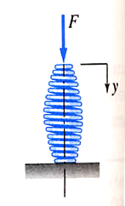
Helical Springs: Types

Slide 11
Helical Spring Ends
Plain
Squared
End coil preparation for compression springs
Plain
Has an uninterrupted helicoid
for all coils
Squared (Closed)
End coils are deformed to
give a zero helix angle
Ground
Flat surfaces are created on
the end coils
Better load transfer is obtained using squared and ground end coils
Ground &
Squared
Ground

Slide 12
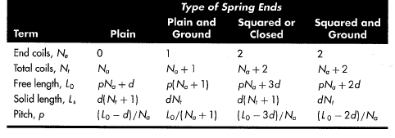
Helical Spring Ends
Key values tabulated
Due to end conditions, not all coils are active
Plain
Squared

Slide 13
Spring Geometric Constraints
The envelop defines the space constraints in which the spring must operate
Diameter constraints (in a hole, on a rod, free)
Allowance is needed:
allow
d_{rod}/2
allow
d_{hole}/2
D/2
D/2
In a Hole
On a Rod
Free

Slide 14
Spring Geometric Constraints
4 ≤ C ≤ 12
3 ≤ N_{a} ≤ 15
Possible length constraints (based on application)
Open length (free of load)
Length with minimum load
Length with maximum load
Solid length

Slide 15
Force and Stresses
From previous section
Where
τ must remain below yield (with a safety factor)

Slide 16
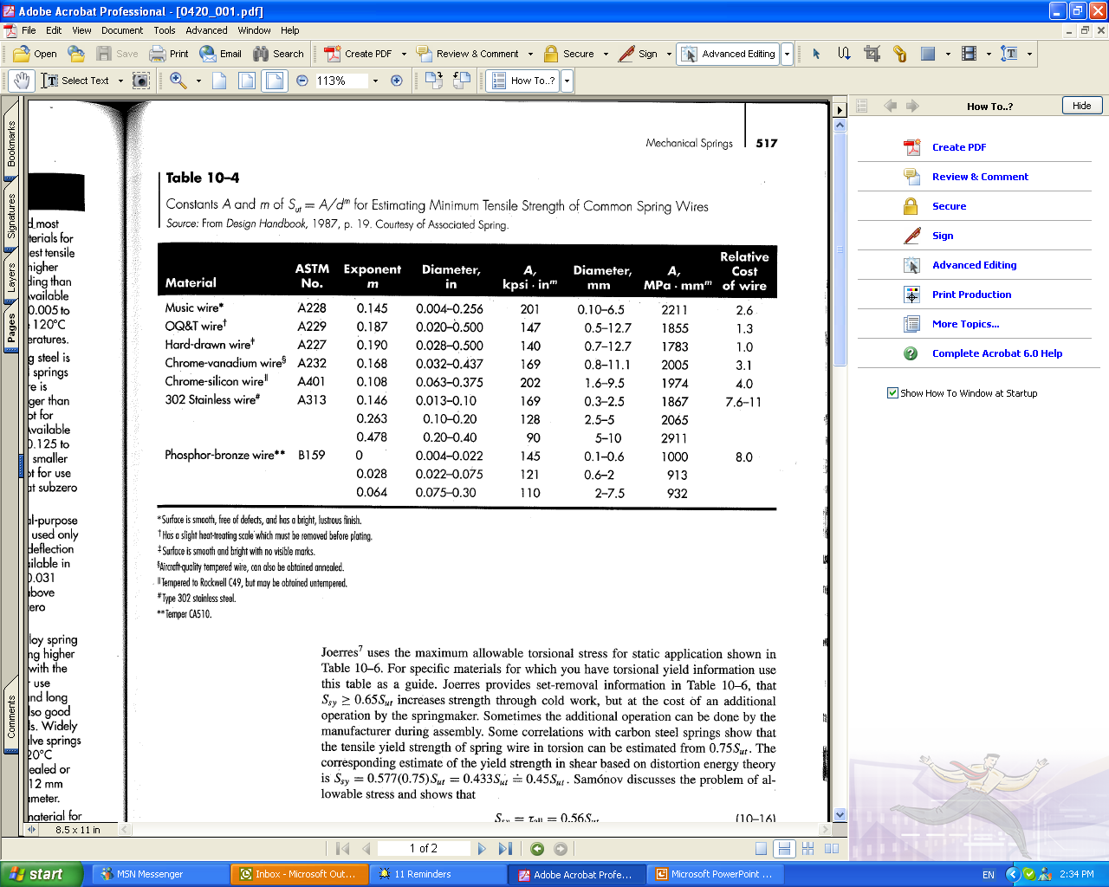
Spring Material Properties
Ultimate tensile strength, S_{ut}
Varies significantly with the wire size (cannot be specified until size is selected)
A
log S_{ut}
m
1
log d

Slide 17
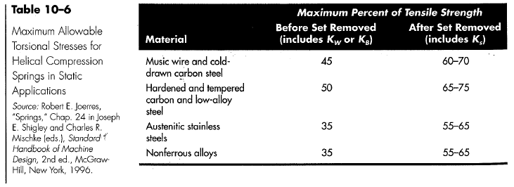
Spring Material Properties
Torsional yield strength (S_{sy}) and shear modulus of rupture (S_{su}) are required for design
Spring materials are typically tested for tensile strengths (S_{y}, S_{ut}) only
S_{su}= 0.67 S_{ut}
S_{sy} also reduced from S_{ut} (see table)

Slide 18
Spring Material Properties
Normal spring condition is called “as wound”
Can “preset” springs (also called “set removal”)
Induces useful residual stresses
Increases stress spring can handle
Set removal should not be used with springs experiencing fatigue loading

Slide 19
Spring Physics: Deflection
How does force relate to deflection?
Spring rate or scale of the spring, k
Obtained using Castigliano’s theorem
Relates work input to strain energy stored
Maximum possible deflection
Solid safe:

Slide 20
Deflection: Spring Clash
Coils of spring come into contact gradually as the spring approaches its solid length
Non-linearity spring rate
Use fractional overrun, ξ
F
F
F_{s}
F_{max}
Coil in contact
Coil out
of contact
y
Non-Linear
Linear
Non-Linear
Coil in contact
F
F

Slide 21
Spring Physics: Stability
Long thin springs in compression are prone to buckling if the loads are too large
Absolute stability (cannot buckle)
α comes from end conditions (see Table 10-2)
Both ends clamped, α = 0.5
One end clamped, one end free, α = 0.707
Both ends hinged, α = 1.0
F
F
For steels

Slide 22
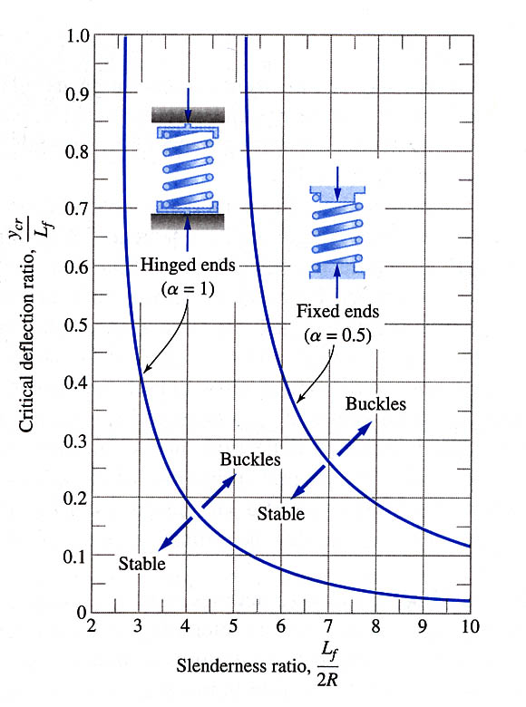
Stability
For small deflections, springs can still be safe if absolute stability is not met
y_{crit}/L₀
L₀/D

Slide 23
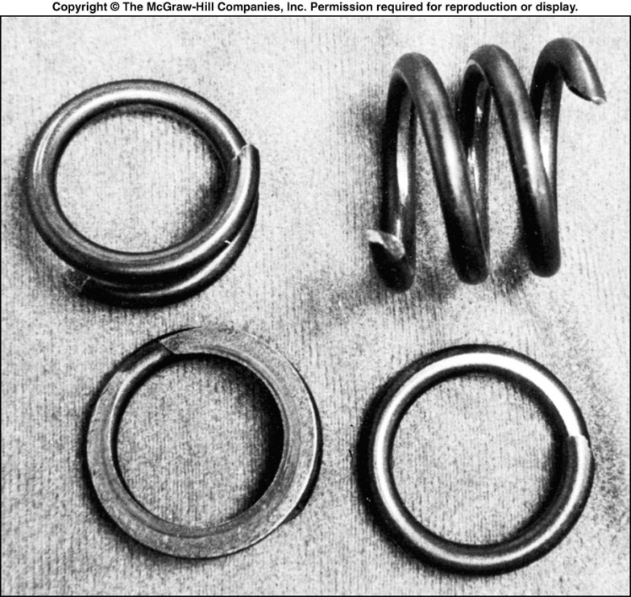
Spring Physics: Spring Surge
Compression waves traveling back and forth along the spring are generated

Slide 24
Spring Physics: Spring Surge
First fundamental frequency
When the application involves rapid reciprocating motion the natural frequency of the spring should not be close to that of the applied force

Slide 25
Design for Fatigue Loading
Goal: Check if safety factor is sufficient
Mean and alternating loads and stresses on springs
F
F_{max}
B
B
B
F_{min}
A
A
A
t

Slide 26
Design for Fatigue Loading
Fatigue Design requires Shear Endurance Limits (S_{se})
Zimmerli data for steel springs can be used
Found that the size, material and tensile strength have no effect on endurance limit
 | Alternating Strength (S_{sa}) | Midrange Strength (S_{sm})
Un-peened | 35 kpsi (241 MPa) | 55kpsi (379 MPa)
Shot-peened (1/64” shot size) | 57.5 kpsi (398MPa) | 77.5 kpsi (534 MPa)

Slide 27
Design for Fatigue Loading
Failure criteria for torsional loading
Sines failure criterion: For polished, notch-free, cylindrical specimens subject to torsional shear stress, the maximum alternating stress that can be applied is constant and independent of the mean stress providing torsional yield is not exceeded.
or
Goodman, Gerber, ASME Elliptic etc.: Apply one of the standard fatigue failure criteria that relates alternating and mean stress components

Slide 28
Sines Fatigue Failure Criterion
Using Sines criterion:
Fit Zimmerli data to criteria
Find shear endurance limit (S_{se}) based on criteria
Find safety factor
τ_{a}
Design point
(S_{sa})_{Z}
Z
(τ_{a})_{D}
D
Zimmerli data point
(τ_{m})_{D}
(S_{sm})_{Z}
τ_{m}

Slide 29
Gerber Fatigue Failure Criterion
Using Gerber Criterion
Fit Gerber locus through Zimmerli data point
Find S_{se}. Note that this changes with S_{su}.
τ_{a}
Design point
S_{se}
(S_{sa})_{Z}
Z
Zimmerli data point
(τ_{a})_{D}
D
(τ_{m})_{D}
(S_{sm})_{Z}
S_{su}
τ_{m}

Slide 30
Helical Spring Selection Process
A challenging problem. Why?
Generic steps (details depend on problem)
Select candidate wire diameter d
Select candidate material (find S_{ut}, S_{sy},…)
Consider envelope constraints (limits D) and geometric constraints in problem (e.g. limits L_{s}, L_{o})

Slide 31
Helical Spring Selection Process
Suggested steps (cont’)
Determine force to close (F_{s}) from max force (F_{max}) and determine maximum stress (relates to C → D/d)
Ensure maximum stress, τ, below shear yield, S_{sy}
Based on spring rate, k, determine remaining spring parameters (e.g. N_{a}, N_{e}, L_{s}, L_{o}, etc.)
Ensure constraints on C and N_{a} are met
Ensure length below critical length for buckling
Ensure critical frequency suitable
If necessary, use figure of merit (cost) (eq. 10-22) to select best spring from possible candidates

Slide 32
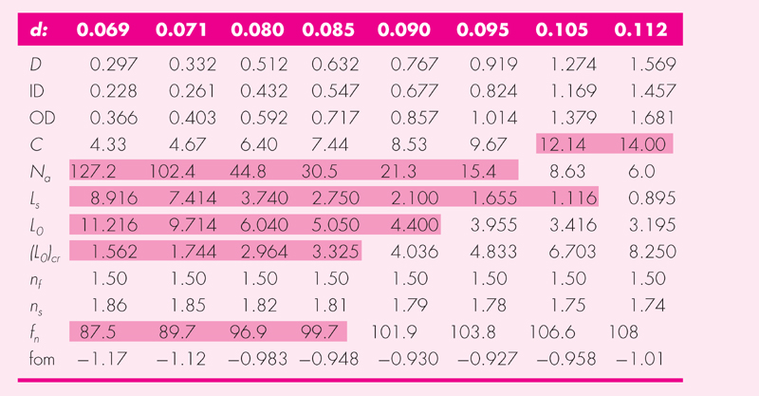
Helical Spring Selection Process
Can automate using spreadsheet
See Table A-28 for standard wire sizes

Slide 33
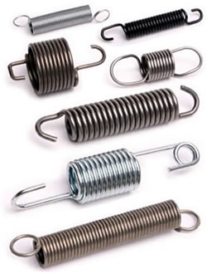
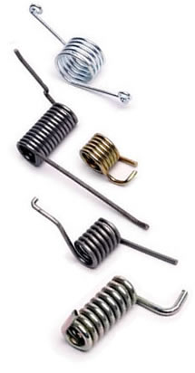
MECH 325 Extension and Helical Springs

Slide 34
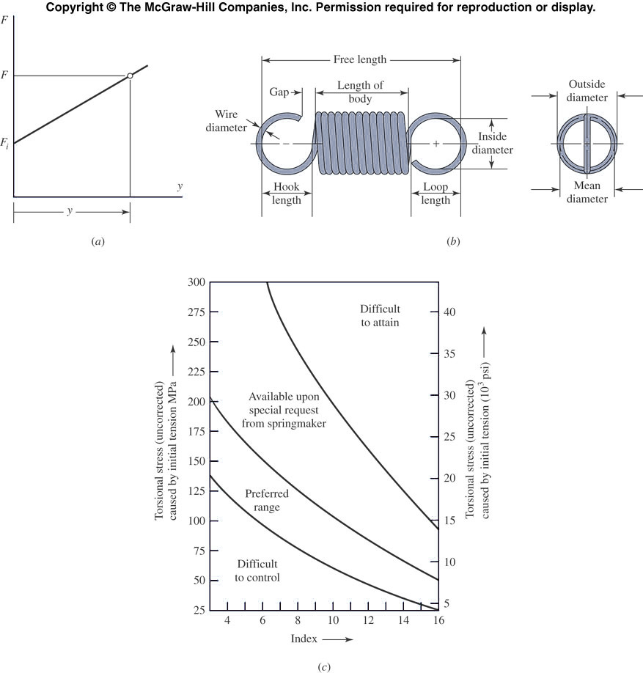
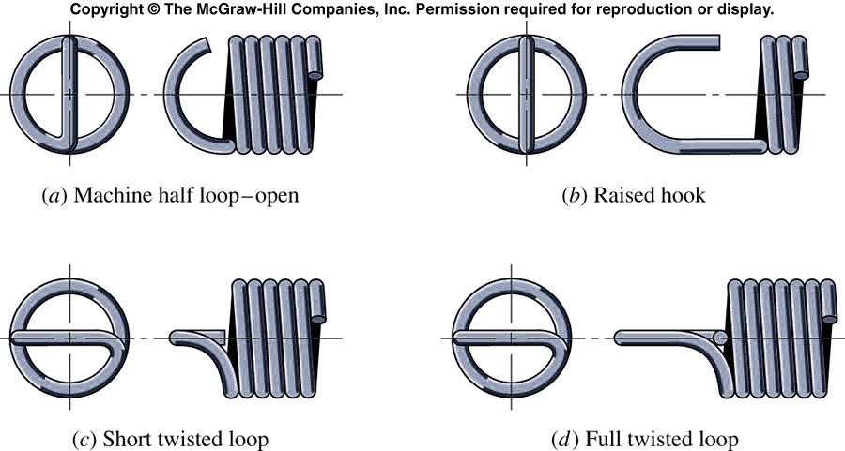
Extension Springs
Carry tensile loads using “loop” or “hook” to transfer the load from the support to the spring body
Types of ends for
extension springs

Slide 35
Extension Spring Spring Rate
As with compression springs, the spring rate is
What do we use for N?

Slide 36
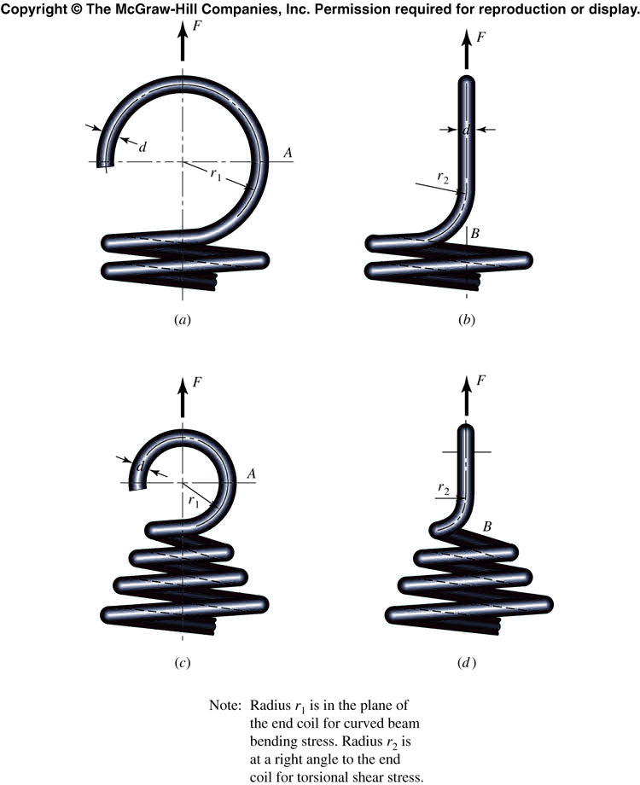
Extension Spring: Stresses
Critical stress locations:

Slide 37
Extension Spring: Stresses
Coil body
End - Location A
End - Location B

Slide 38
Initial Spring Tension
Manufacturers use some initial tension.
Why?
Generated by twisting the wire during the winding process
F
y

Slide 39
Initial Spring Tension
Uncorrected torsional stress induced by initial tension

Slide 40

Extension Spring Material Properties
Static applications: different strengths required for torsion in body, bending in spring ends (location A) and bending in spring ends (location B)
Fatigue loading: Use Zimmerli data as for compression springs

Slide 41
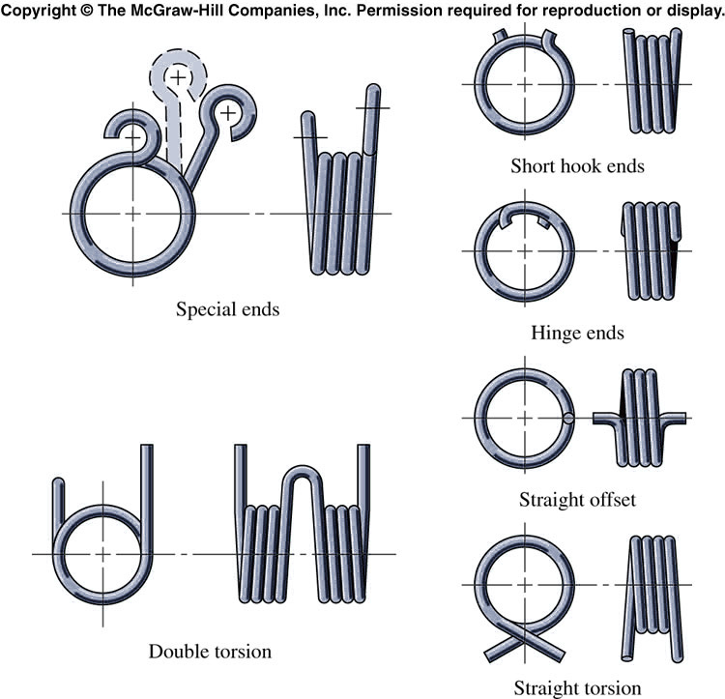
Helical Coil Torsion Springs
Springs that are subjected to end torsion
Close wound (coils are in contact) but with no initial tension
Ends are configured to support torsion being applied to the spring coil
Rods maybe used for alignment and to provide resistance to buckling
Coils experience bending stresses

Slide 42
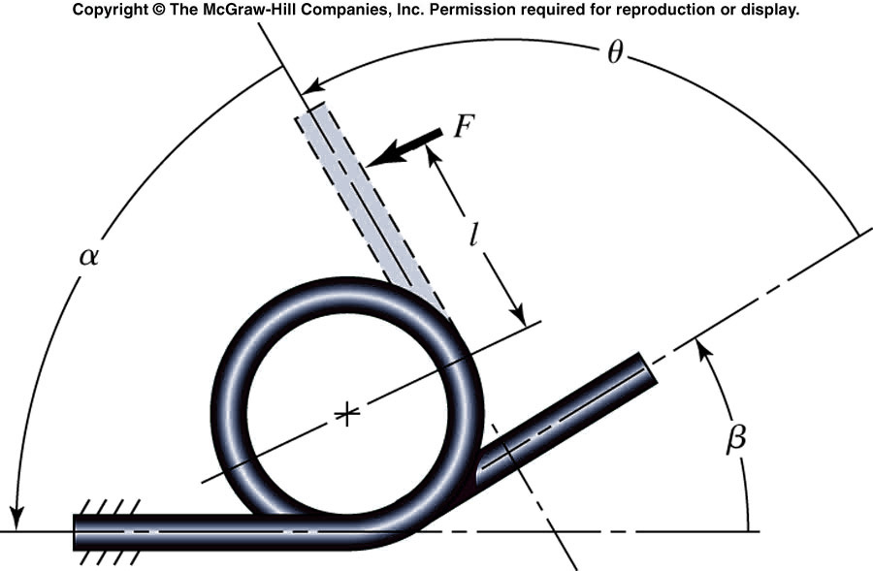
Torsion Spring Stresses
Bending Stresses
K = stress-correction factor
Maximum stress on the inside of coil

Slide 43
Torsion Spring Deflection
Total angular deflection

Slide 44
Torsion Spring Deflection
Deflection often expressed in turns (rather than radians)
Effect of friction between coils and arbor decreases the spring rate by ~5% (constant 10.2 → 10.8, or 64 → 68)
Spring rate

